Slide 1
Job Title: "Junior Data Analyst Role at Upen Group“ - Soumya Vardhana Gari
INFO 5307 - Knowledge Management Tools and Technologies

Slide 2
Introduction
This job talk, proposes the use of data analysis and knowledge management tools to address some business challenges in banking and financial industry.
Role Relevance: Junior Data Analyst in Upen Group
The main role of a Junior Data Analyst involves primary tasks such as data analysis, reporting and presentation of the insights that could be used to enhance the performance of products.
In my recent project, I tackled a real-world business challenge.
The research topic focuses on customer churn in the banking sector. I worked with a customer data of 10000 records from Kaggle and analyzed the data to find out drivers of churn and solutions to it. I see a correlation of this experience with the Upen Group’s goal of writing strategic policy for decision making and working with stakeholders.

Slide 3
Problem Definition
Customer churn is also deemed major problem of financial institutions.
High churn rates are not only negative from the perspective of revenue but also in view of the fact that all acquisition costs rise.
The problem arises in terms of identifying customer actions and behavior, and anticipating who is most likely to churn over.
For this study, I employed the ‘Bank Customer Churn Dataset’ obtained from Kaggle, which contains the demographic information of the customers, their accounts, and their churn labels. Looking at this dataset, I was able to identify causes of churn and potentially viable strategies for reducing this problem.

Slide 4
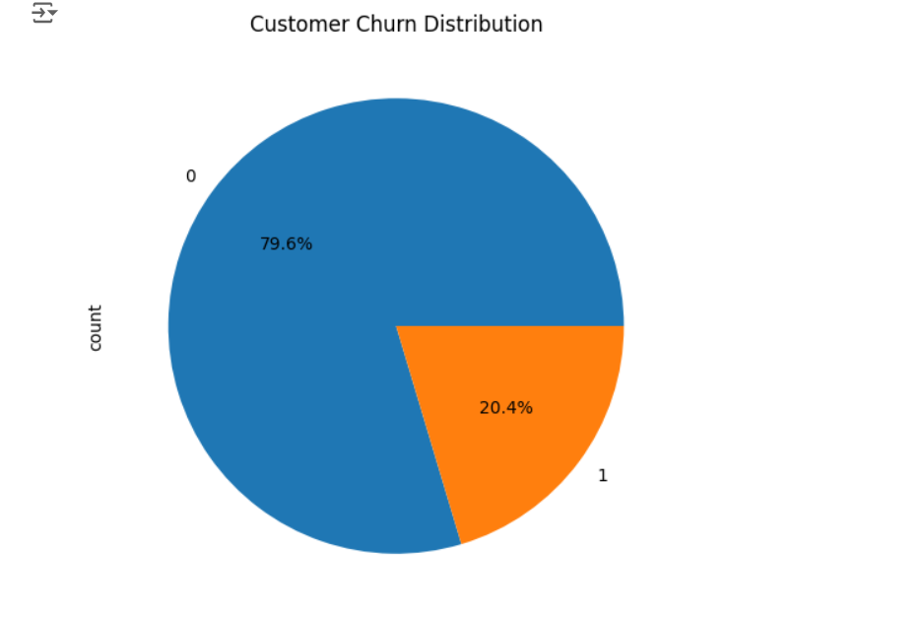
Tools and Techniques
For this project, I followed a structured, data-driven approach. First, I applied the methods of data preprocessing and cleaning in the Python environment pandas and NumPy.
It also feature engineered categorical variables into dummy variables for model training. Thereafter, I proceeded to use EDA to find out thing like churn based on the account balance and the length of stay.
To make more sense of these trends, I turned to Python’s matplotlib and seaborn packages to build these graphics.

Slide 5
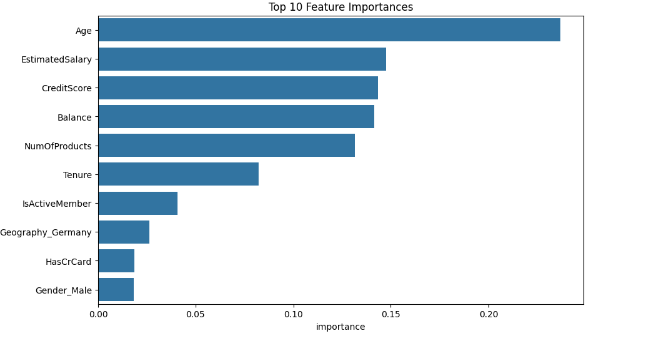
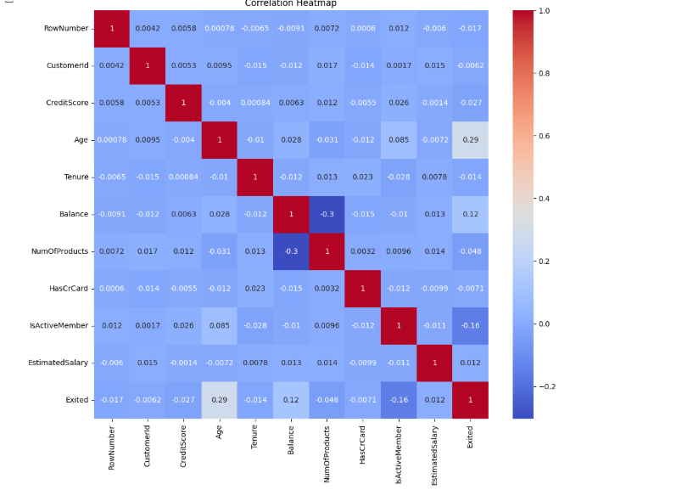
Tools and Techniques
Next, I predicted churn using machine learning models such as Logistic Regression, Random Forest and Gradient Boosting.
These models were used to determine potential determinants that included customer traffic frequency and duration of customer association with the firm.

Slide 6
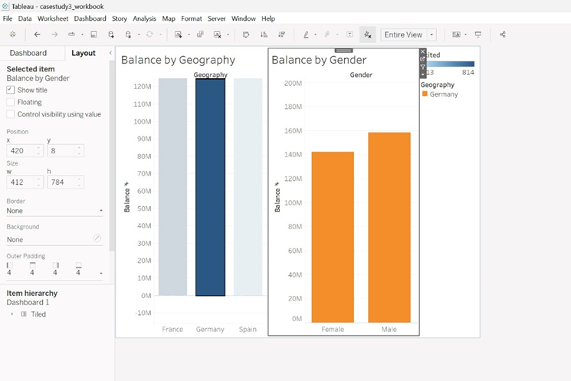
Tools and Techniques
I developed an interactive dashboard by employing Tableau. This let me present the results to various stakeholders in simple forms even for those without constitutions of technical understanding.

Slide 7
Results and Insights
Loyal bank customers that had lower balances and less past account length were more likely churn. To be specific, fewer first quarter active customers left compared with the other months while less credit score customers were more likely to churn.
The Logistic Regression model had an accuracy of 83% when predicting the non churn customer, while the Random Forest model optimized recall up to 47%, enhancing the possibility of recognizing customers at high risk.
These insights were presented via a Tableau dashboard.
For instance, churn comparison per customer segment for better strategy on retention. It shows how I take raw data and analyze it for decision making which will match what Upen Group is looking forward to as a company that would prefer data analysis in its operational processes.

Slide 8
Conclusion
Altogether the experience of this project can help me to show that I can analyze large datasets, explain the results and choose the correct knowledge management instrument to deal with the emerging problem.
In my current position at Upen Group, I think I can effectively apply my SQL skills together with Tableau to your team.

Slide 9
Thank You

